Slide 1

Heart disease prediction using machine learning
Presented by -
Ananya chowdary (197r1a05j6)
Sai pranav guntha (197r1a05l4)
Sumanth ch (197r1a05k1)
Project guide -
Najeema afrin

Slide 2

contents
Abstract
Introduction
Existing System
Proposed System
Hardware Requirements
Software Requirements
Novelty
Architecture
Module
UML Diagrams
Output
Conclusion
Future Enhancements
References
GitHub Link

Slide 3
ABSTRACT
Cardio Vascular Diseases(CVD's) are the main reason for a huge number of deaths in the world over the last few decades and has emerged as the most life-threatening disease.
There is a need of reliable, accurate and feasible system to diagnose such diseases in time. Using the huge amount of data that the Health care industry produce a disease can be predicted, detected or even cured.
Machine Learning algorithms, techniques and medical data (Blood pressure, hypertension, cigarettes smoked per day) are used for the prediction of the disease.
Algorithms used are - K-Nearest Neighbour, Decision Tree, Random Forest.

Slide 4
EXISting system
Prediction using traditional methods and models involves various risk factors and it consists of various measures of algorithms such as datasets, programs and much more to add on.
High-risk and Low-risk patient classification is done on the basis of the tests that are done in group. But these models are only valuable in clinical situations and not in big industry sector.
So, to include the disease predictions in various health related industries, we have used the concepts of machine learning and supervised learning methods to build the predictions system. Existing model gives less accuracy.
DISADVANTAGES:
There is a high probability of overfitting in Decision Tree.
Generally, it gives low prediction accuracy for a dataset as compared to other machine learning algorithms.
Information gain in a decision tree with categorical variables gives a biased response for attributes with greater number

Slide 5
PROPOSED SYSTEM:
In the proposed system various techniques, algorithms and tools are used to create a system which predicts the disease of the patient
The dataset and symptoms go to the prediction model of the system where the data is pre-processed for the future references
Then the classification of that data is done with the help of Random Forest algorithm and the data goes in the recommendation model, there it shows the risk analysis that is involved in the system.
The structured and unstructured form of data are combined for the overall risk analysis that is required for predicting the disease.
Structured analysis is used to identify the chronic disease in a particular region and community. Unstructured analysis is used to select the features automatically with the help of algorithms and techniques.
ADVANTAGES:
Random algorithms avoids and prevents overfitting by using multiple trees.
This gives accurate and precise results.

Slide 6



REQUIREMENTS:
HARDWARE REQUIREMENTS:
RAM: 4 gb and above (8 or 16 recommended).
Hard Disk: 15 gb and above.
Processor: Core 2 duo and above.
SOFTWARE REQUIREMENTS:
Windows 7 and above
Python 3.7 and above
Pandas,numpy,sklearn

Slide 7
NOVELTY:
The novelty of this project (Heart disease prediction) is that we are using various advanced techniques and algorithms to build a system that predicts patient’s disease using the previous dataset’s symptoms. Random Forest algorithm is used for pre-processing and classification of data. Risk analysis will be displayed in the prediction model. Structured and unstructured data is used for the risk analysis where, structured analysis is used to identify the chronic disease in a particular region. Unlike in the existing system, here we use the Random Forest algorithm that helps us with the better results with more accuracy by avoiding overfitting in the decision tree. In this project we use various algorithms and take the information of patients as input and check the previous dataset and analyse the risk analysis of the patient. The results that are predicted in this system are more accurate and precise.

Slide 8
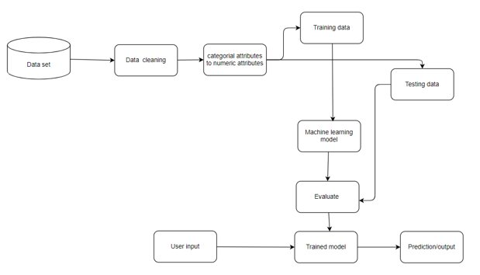
ARCHITECTURE

Slide 9
MODULE:
Importing libraries and datasets
Data processing
Splitting dataset into Training and Testing data
Classifying data for KNN algorithm
Decision tree classifier
Random forest classifier
Prediction of new data given by the user

Slide 10
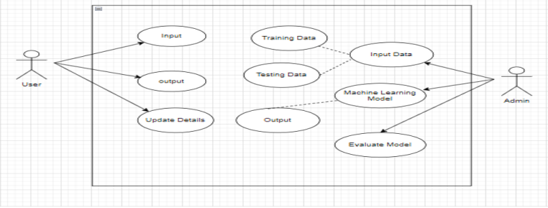
UML DIAGRAMS:
Use Case Diagram:

Slide 11
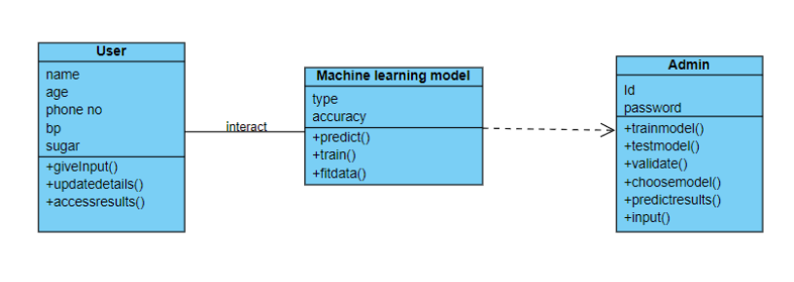
UML DIAGRAMS:
Class Diagram:

Slide 12
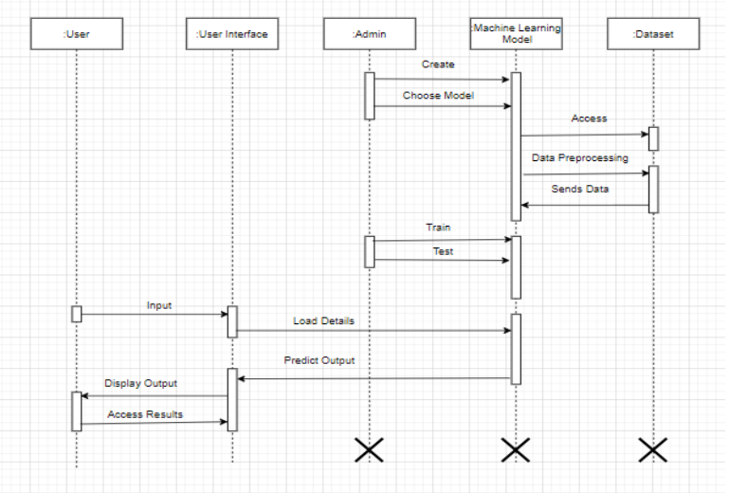
UML DIAGRAMS:
Sequence Diagram:
UML DIAGRAMS:​

Slide 13
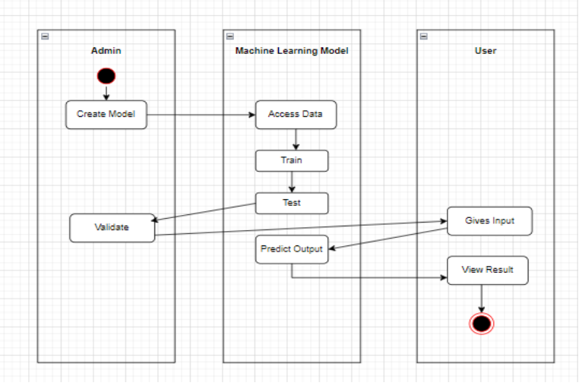
UML DIAGRAMS:
Activity Diagram:

Slide 14
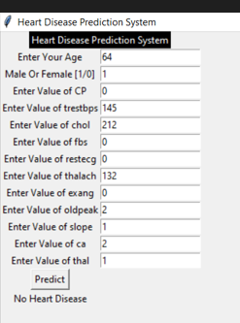
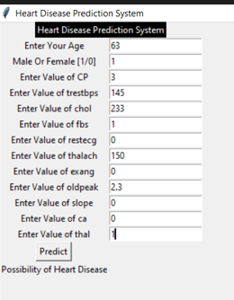
Output:

Slide 15
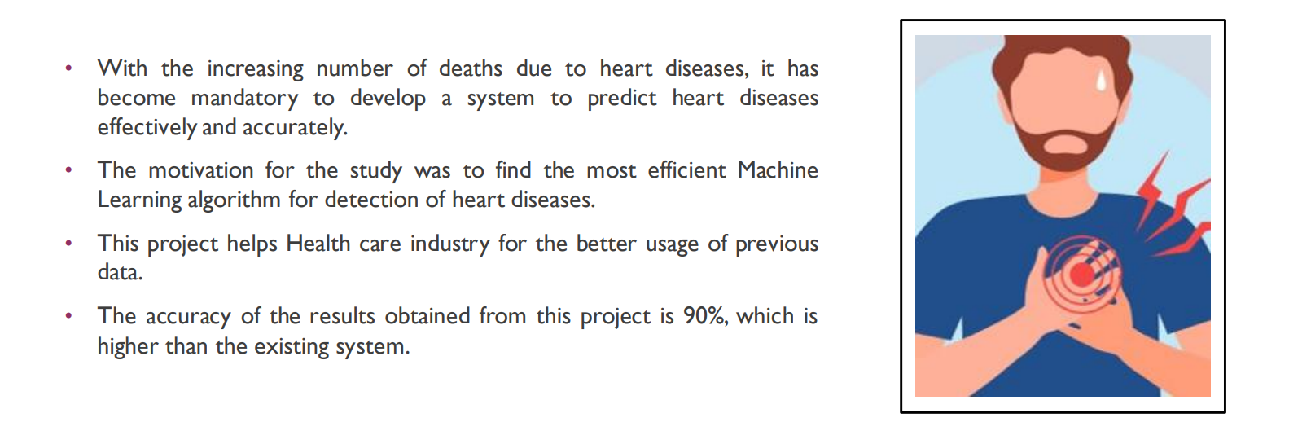
Conclusion:

Slide 16
Future enhancement
The accuracy of out project is around 90 percent, but with time and advanced hardware we can try to further improve the accuracy of our project .
The dataset we used is available for public access. But the datasets that are available to public are very old data and is very less, so we would like to further improve the training process by providing bigger datasets.
With availability of advanced hardware, we can further reduce the time taken to predict the results.
We also have plans to further improve the GUI( graphical user interface).

Slide 17
references
Senthilkumar Mohan, Chandrasegar Thirumalai, Gautam Srivastava ―Effective Heart Disease Prediction Using Hybrid Machine Learning Techniques‖, Digital Object Identifier 10.1109/ACCESS.2019.2923707, IEEE Access, VOLUME 7, 2019 S.P. Bingulac, ―On the Compatibility of Adaptive Controllers,‖ Proc. Fourth Ann. Allerton Conf. Circuits and Systems Theory, pp. 8-16, 1994. (Conference proceedings)
Sonam Nikhar, A.M. Karandikar” Prediction of Heart Disease Using Machine Learning Algorithms” International Journal of Advanced Engineering, Management and Science (IJAEMS) Infogain Publication,[Vol-2, Issue-6, June- 2016].I.S. Jacobs and C.P. Bean, “Fine particles, thin films and exchange anisotropy,” in Magnetism, vol. III, G.T. Rado and H. Suhl, Eds. New York: Academic, 1963, pp. 271-350.
Aditi Gavhane, Gouthami Kokkula, Isha Pandya, Prof. Kailas Devadkar (PhD),” Prediction of Heart Disease Using Machine Learning”, Proceedings of the 2nd International conference on Electronics, Communication and Aerospace Technology (ICECA 2018).IEEE Conference Record # 42487; IEEE Xplore ISBN:978-1- 5386-0965-1
3. https://www.medicalnewstoday.com/articles/257484.php

Slide 18
GIThub link
https://github.com/ananyaj6/project-college

Slide 19


